Slide 1

IT5002
Computer Systems and Applications
Caches
colintan@nus.edu.sg

Slide 2
Q & A
DO NOT use the Zoom chat for questions. It doesn’t appear in the video recordings.
Please ask questions at https://sets.netlify.app/module/61597486a7805d9fb1b4accd
OR scan this QR code (may be obscured on some slides)

Slide 3
1. Data Transfer: The Big Picture
Computer
Processor
Memory
Devices
Control
Input
Datapath
+
Registers
Store to memory
Output
Load from memory
Registers are in the datapath of the processor. If operands are in memory we have to load them to processor (registers), operate on them, and store them back to memory.

Slide 4
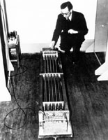
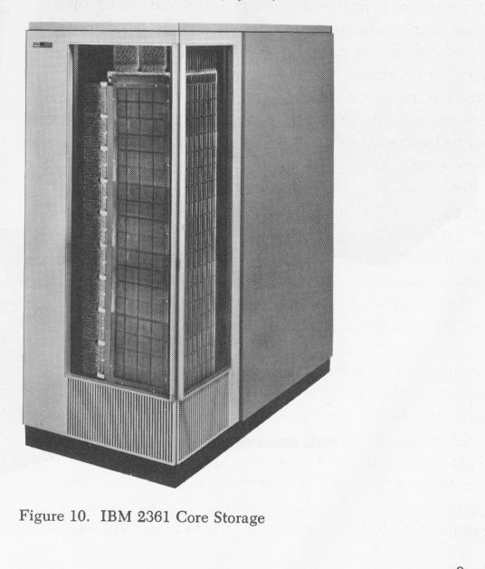
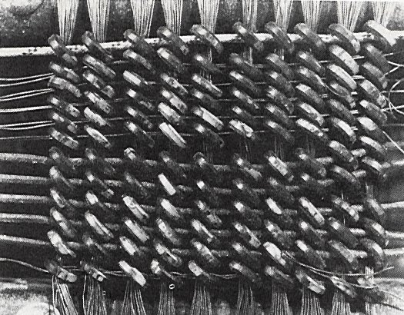

1. Memory Technology: 1950s
1948: Maurice Wilkes examining
EDSAC’s delay line memory tubes
16-tubes each storing 32 17-bit words
1952: IBM 2361 16KB magnetic core memory
Maurice Wilkes: 2005

Slide 5
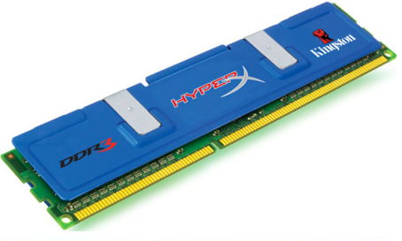
1. Memory Technology Today: DRAM
DDR SDRAM
Double Data Rate
– Synchronous Dynamic RAM
The dominant memory technology in PC market
Delivers memory on the positive and negative edge of a clock (double rate)
Generations:
DDR (MemClkFreq x 2(double rate) x 8 words)
DDR2 (MemClkFreq x 2(multiplier) x 2 x 8 words)
DDR3 (MemClkFreq x 4(multiplier) x 2 x 8 words)
DDR4 (Lower power consumption, higher bandwidth)

Slide 6
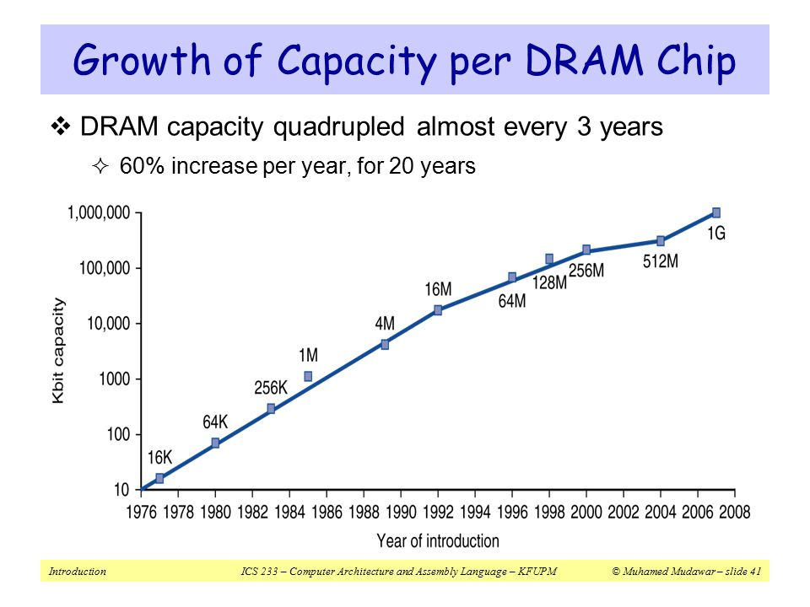
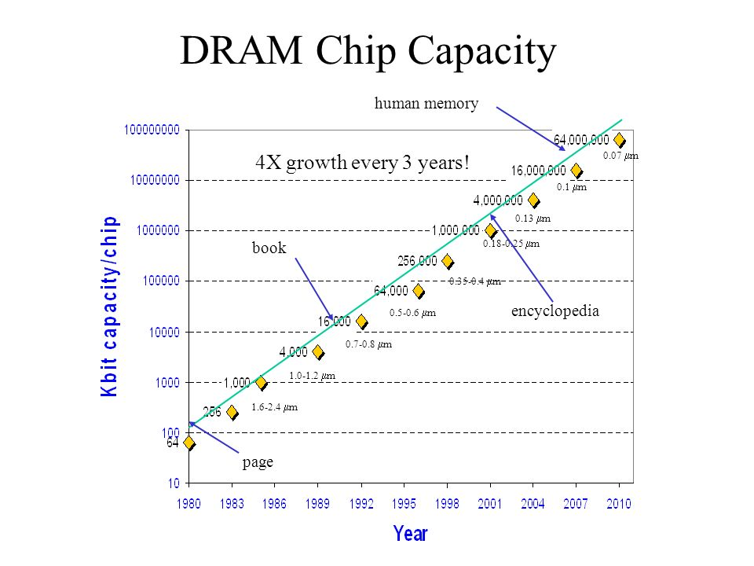
1. DRAM Capacity Growth
Unprecedented growth in density, but we still have a problem

Slide 7
1. Processor-DRAM Performance Gap
Memory Wall:
1GHz Processor ➔ 1 ns per clock cycle
50ns for DRAM access ➔ 50 processor clock cycles per memory access!
1000
CPU
“Moore’s Law”
Gordon Moore noticed that the number of transistors per square inch on integrated circuits had doubled every year/18 months since their invention.
100
Performance
10
DRAM
1
1980
Time
1981
1982
1983
1984
1985
1986
1987
1988
1989
1990
1991
1992
1993
1994
1995
1996
1997
1998
1999
2000

Slide 8
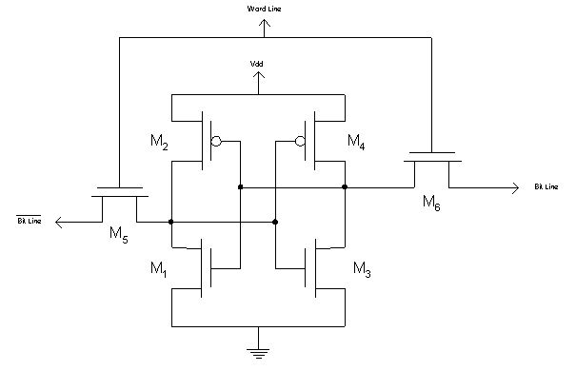
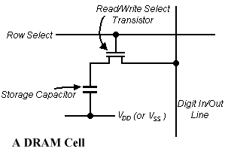
1. Faster Memory Technology: SRAM
A SRAM Cell
SRAM
6 transistors per memory cell
→ Low density
Fast access latency of 0.5 – 5 ns
More costly
Uses flip-flops
DRAM
1 transistor per memory cell
→ High density
Slow access latency of 50-70ns
Less costly
Used in main memory

Slide 9
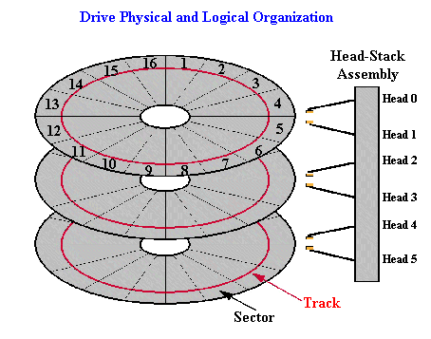
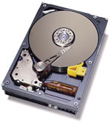
1. Slow Memory Technology: Magnetic Disk
Typical high-end hard disk:
Average Latency: 4 - 10 ms
Capacity: 500-2000GB

Slide 10
1. Quality vs Quantity
Processor
Memory
(DRAM)
Devices
Control
Input
Datapath
Registers
Output
(Harddisk)
 | Capacity | Latency | Cost/GB
Register | 100s Bytes | 20 ps | $$$$
SRAM | 100s KB | 0.5-5 ns | $$$
DRAM | 100s MB | 50-70 ns | $
Hard Disk | 100s GB | 5-20 ms | Cents
Ideal | 1 GB | 1 ns | Cheap

Slide 11
1. Best of Both Worlds
What we want:
A BIG and FAST memory
Memory system should perform like 1GB of SRAM (1ns access time) but cost like 1GB of slow memory
Key concept:
Use a hierarchy of memory technologies:
Small but fast memory near CPU
Large but slow memory farther away from CPU

Slide 12
1. Memory Hierarchy
Registers
SRAM
Speed
DRAM
Harddisk
Size

Slide 13

2. Cache: The Library Analogy
Imagine you are forced to put back a book to its bookshelf before taking another book…….

Slide 14
2. Solution: Book on the Desk!
What if you are allowed to take the books that are likely to be needed soon with you and place them nearby on the desk?

Slide 15
2. Cache: The Basic Idea
Keep the frequently and recently used data in smaller but faster memory
Refer to bigger and slower memory:
Only when you cannot find data/instruction in the faster memory
Why does it work?
Principle of Locality
Program accesses only a small portion of the
memory address space within a small time interval

Slide 16
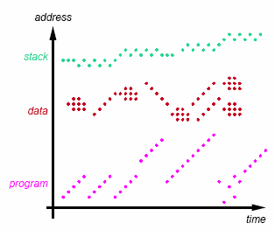
2.1 Cache: Types of Locality
Temporal locality
If an item is referenced, it will tend to be referenced again soon
Spatial locality
If an item is referenced, nearby items will tend to be referenced soon
Different locality for
Instructions
Data

Slide 17
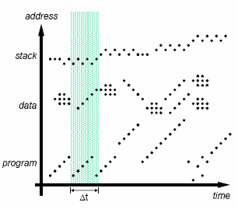
2.1 Working Set: Definition
Set of locations accessed during Δt
Different phases of execution may use different working sets
Our aim is to capture the working set and keep it in the memory closest to CPU

Slide 18
2.2 Two Aspects of Memory Access
Processor
Memory
(DRAM)
Devices
Control
Input
Datapath
Registers
Cache
(SRAM)
Output
(Harddisk)
How to make SLOW main memory appear faster?
Cache – a small but fast SRAM near CPU
Hardware managed: Transparent to programmer
How to make SMALL main memory appear bigger than it is?
Virtual memory
OS managed: Transparent to programmer
Not in the scope of this module (covered in CS2106)

Slide 19
2.2 Memory Access Time: Terminology
Processor
Memory
Cache
X
Y
Hit: Data is in cache (e.g., X)
Hit rate: Fraction of memory accesses that hit
Hit time: Time to access cache
Miss: Data is not in cache (e.g., Y)
Miss rate = 1 – Hit rate
Miss penalty: Time to replace cache block + hit time
Hit time < Miss penalty

Slide 20
2.2 Memory Access Time: Formula
Average Access Time
= Hit rate x Hit Time + (1-Hit rate) x Miss penalty
Example:
Suppose our on-chip SRAM (cache) has 0.8 ns access time, but the fastest DRAM (main memory) we can get has an access time of 10ns. How high a hit rate do we need to sustain an average access time of 1ns?
Let h be the desired hit rate.
1 = 0.8h + (1 – h) × (10 + 0.8) = 0.8h + 10.8 – 10.8h
10h = 9.8 → h = 0.98
Hence we need a hit rate of 98%.


Slide 21
3. Memory to Cache Mapping (1/2)
Cache Block/Line:
Unit of transfer between memory and cache
Block size is typically one or more words
e.g.: 16-byte block ≅ 4-word block
32-byte block ≅ 8-word block
Why is the block size bigger than word size?

Slide 22
3. Memory to Cache Mapping (2/2)
Address
8-byte blocks
Block
Word
..00000
Byte
..00001
Word0
..00010
..00011
Block0
..00100
Observations:
2^{N}-byte blocks are aligned at 2^{N}-byte boundaries
The addresses of words within a 2^{N}-byte block have identical (32-N) most significant bits (MSB).
Bits [31:N] ➔ the block number
Bits [N-1:0] ➔ the byte offset within a block
..00101
Word1
..00110
..00111
..01000
..01001
Word2
..01010
..01011
Block1
Memory Address
..01100
31
N
N-1
0
..01101
Word3
Block Number
Offset
..01110
..01111

Slide 23
4. Direct Mapping Analogy
Imagine there are 26 “locations” on the desk to store books. A book’s location is determined by the first letter of its title.
➔ Each book has exactly one location.

Slide 24
4. Direct Mapped Cache: Cache Index
Block Number (Not Address!)
Cache Index
..00000
One block
One block
00
Index
..00001
01
..00010
10
..00011
Mapping Function:
Cache Index
= (BlockNumber) modulo
(NumberOfCacheBlocks)
11
..00100
Cache
..00101
..00110
Memory
..00111
..01000
Observation:
If Number of Cache Blocks = 2^{M}
➔ the last M bits of the block number is the cache index
Example:
Cache has 2² = 4 blocks
➔ last 2 bits of the block number is the cache index.
..01001
..01010
..01011
..01100
..01101
..01110
..01111

Slide 25
4. Direct Mapped Cache: Cache Tag
Block Number (Not Address!)
Cache Index
..00000
One block
One block
00
..00001
01
Tag
..00010
10
..00011
Mapping Function:
Cache Index
= (BlockNumber) modulo
(NumberOfCacheBlocks)
11
..00100
Cache
..00101
..00110
Memory
..00111
..01000
Observation:
Multiple memory blocks can map to the same cache block
➔ Same Cache Index
However, they have unique tag number:
Tag = Block number / Number of Cache Blocks
..01001
..01010
..01011
..01100
..01101
..01110
..01111

Slide 26
4. Direct Mapped Cache: Mapping
Memory Address
31
N
N-1
0
Block Number
Offset
Cache Block size = 2^{N} bytes
Memory Address
31
N+M-1
N
N-1
0
Tag
Index
Offset
Cache Block size = 2^{N} bytes
Number of cache blocks = 2^{M}
Offset = N bits
Index = M bits
Tag = 32 – (N + M) bits

Slide 27
4. Direct Mapped Cache: Cache Structure
Valid
Tag
Data
Index
Cache
00
01
10
11
Along with a data block (line), cache also contains the following administrative information (overheads):
Tag of the memory block
Valid bit indicating whether the cache line contains valid data
When is there a cache hit?
( Valid[index] = TRUE ) AND ( Tag[ index ] = Tag[ memory address ] )

Slide 28
4. Cache Mapping: Example
Memory Address
Memory
4GB
31
N
N-1
0
Block Number
Offset
Offset, N = 4 bits
Block Number = 32 – 4 = 28 bits
Check: Number of Blocks = 2²⁸
1 Block
= 16 bytes
31
N+M-1
N
N-1
0
Cache
16KB
Tag
Index
Offset
Number of Cache Blocks
= 16KB / 16bytes = 1024 = 2¹⁰
Cache Index, M = 10bits
Cache Tag = 32 – 10 – 4 = 18 bits
1 Block
= 16 bytes

Slide 29
4. Cache Circuitry: Example
16-KB cache: 4-word (16-byte) blocks
Hit
31 30 . . . 15 14 13 . . . 5 4 3 2 1 0
Data
Tag
Index
Ofst
Tag
18
10
2 (Addr[3:2])
Block offset
Index
Data
Valid
Tag
Word0
Word1
Word2
Word3
0
1
2
.
.
.
1022
1023
18
Cache Hit =
[Tag Matches] AND [Valid]
MUX
32

Slide 30
5. Reading Data: Setup
Given a direct mapped 16KB cache:
16-byte blocks x 1024 cache blocks
Trace the following memory accesses:
Tag
Index
Offset
31
14
13
4
3
0
000000000000000000
0000000001
0100
000000000000000000
0000000001
1100
000000000000000000
0000000011
0100
000000000000000010
0000000001
1000
000000000000000000
0000000001
0000

Slide 31
5. Reading Data: Initial State
Intially cache is empty
➔ All valid bits are zeroes (false)
Data
Word0
Word1
Word2
Word3
Index
Valid
Tag
Bytes 0-3
Bytes 4-7
Bytes 8-11
Bytes 12-15
0
0
1
0
2
0
3
0
4
0
5
0
... ... ... … … … … …
1022
0
1023
0

Slide 32
5. Reading Data: Load #1-1
Tag
Index
Offset
Load from
Step 1. Check Cache Block at index 1
000000000000000000
0000000001
0100
Data
Word0
Word1
Word2
Word3
Index
Valid
Tag
Bytes 0-3
Bytes 4-7
Bytes 8-11
Bytes 12-15
0
0
1
0
2
0
3
0
4
0
5
0
... ... ... … … … … …
1022
0
1023
0

Slide 33
5. Reading Data: Load #1-2
Tag
Index
Offset
Load from
Step 2. Data in block 1 is invalid [Cold/Compulsory Miss]
000000000000000000
0000000001
0100
Data
Word0
Word1
Word2
Word3
Index
Valid
Tag
Bytes 0-3
Bytes 4-7
Bytes 8-11
Bytes 12-15
0
0
1
0
2
0
3
0
4
0
5
0
... ... ... … … … … …
1022
0
1023
0

Slide 34
5. Reading Data: Load #1-3
Tag
Index
Offset
Load from
Step 3. Load 16 bytes from memory; Set Tag and Valid bit
000000000000000000
0000000001
0100
Data
Word0
Word1
Word2
Word3
Index
Valid
Tag
Bytes 0-3
Bytes 4-7
Bytes 8-11
Bytes 12-15
0
0
1
1
0
A
B
C
D
2
0
3
0
4
0
5
0
... ... ... … … … … …
1022
0
1023
0

Slide 35
5. Reading Data: Load #1-4
Tag
Index
Offset
Load from
Step 4. Return Word1 (byte offset = 4) to Register
000000000000000000
0000000001
0100
Data
Word0
Word1
Word2
Word3
Index
Valid
Tag
Bytes 0-3
Bytes 4-7
Bytes 8-11
Bytes 12-15
0
0
1
1
0
A
B
C
D
2
0
3
0
4
0
5
0
... ... ... … … … … …
1022
0
1023
0

Slide 36
5. Reading Data: Load #2-1
Tag
Index
Offset
Load from
Step 1. Check Cache Block at index 1
000000000000000000
0000000001
1100
Data
Word0
Word1
Word2
Word3
Index
Valid
Tag
Bytes 0-3
Bytes 4-7
Bytes 8-11
Bytes 12-15
0
0
1
1
0
A
B
C
D
2
0
3
0
4
0
5
0
... ... ... … … … … …
1022
0
1023
0

Slide 37
5. Reading Data: Load #2-2
Tag
Index
Offset
Load from
Step 2. [Cache Block is Valid] AND [Tags match] ➔ Cache hit!
000000000000000000
0000000001
1100
Data
Word0
Word1
Word2
Word3
Index
Valid
Tag
Bytes 0-3
Bytes 4-7
Bytes 8-11
Bytes 12-15
0
0
1
1
0
A
B
C
D
2
0
3
0
4
0
5
0
... ... ... … … … … …
1022
0
1023
0

Slide 38
5. Reading Data: Load #2-3
Tag
Index
Offset
Load from
Step 3. Return Word3 (byte offset = 12) to Register [Spatial Locality]
000000000000000000
0000000001
1100
Data
Word0
Word1
Word2
Word3
Index
Valid
Tag
Bytes 0-3
Bytes 4-7
Bytes 8-11
Bytes 12-15
0
0
1
1
0
A
B
C
D
2
0
3
0
4
0
5
0
... ... ... … … … … …
1022
0
1023
0

Slide 39
5. Reading Data: Load #3-1
Tag
Index
Offset
Load from
Step 1. Check Cache Block at index 3
000000000000000000
0000000011
0100
Data
Word0
Word1
Word2
Word3
Index
Valid
Tag
Bytes 0-3
Bytes 4-7
Bytes 8-11
Bytes 12-15
0
0
1
1
0
A
B
C
D
2
0
3
0
4
0
5
0
... ... ... … … … … …
1022
0
1023
0

Slide 40
5. Reading Data: Load #3-2
Tag
Index
Offset
Load from
Step 2. Data in block 3 is invalid [Cold/Compulsory Miss]
000000000000000000
0000000011
0100
Data
Word0
Word1
Word2
Word3
Index
Valid
Tag
Bytes 0-3
Bytes 4-7
Bytes 8-11
Bytes 12-15
0
0
1
1
0
A
B
C
D
2
0
3
0
4
0
5
0
... ... ... … … … … …
1022
0
1023
0

Slide 41
5. Reading Data: Load #3-3
Tag
Index
Offset
Load from
Step 3. Load 16 bytes from memory; Set Tag and Valid bit
000000000000000000
0000000011
0100
Data
Word0
Word1
Word2
Word3
Index
Valid
Tag
Bytes 0-3
Bytes 4-7
Bytes 8-11
Bytes 12-15
0
0
1
1
0
A
B
C
D
2
0
3
1
0
I
J
K
L
4
0
5
0
... ... ... … … … … …
1022
0
1023
0

Slide 42
5. Reading Data: Load #3-4
Tag
Index
Offset
Load from
Step 4. Return Word1 (byte offset = 4) to Register
000000000000000000
0000000011
0100
Data
Word0
Word1
Word2
Word3
Index
Valid
Tag
Bytes 0-3
Bytes 4-7
Bytes 8-11
Bytes 12-15
0
0
1
1
0
A
B
C
D
2
0
3
1
0
I
J
K
L
4
0
5
0
... ... ... … … … … …
1022
0
1023
0

Slide 43
5. Reading Data: Load #4-1
Tag
Index
Offset
Load from
Step 1. Check Cache Block at index 1
000000000000000010
0000000001
1000
Data
Word0
Word1
Word2
Word3
Index
Valid
Tag
Bytes 0-3
Bytes 4-7
Bytes 8-11
Bytes 12-15
0
0
1
1
0
A
B
C
D
2
0
3
1
0
I
J
K
L
4
0
5
0
... ... ... … … … … …
1022
0
1023
0

Slide 44
5. Reading Data: Load #4-2
Tag
Index
Offset
Load from
Step 2. Cache block is Valid but Tags mismatch [Cold miss]
000000000000000010
0000000001
1000
Data
Word0
Word1
Word2
Word3
Index
Valid
Tag
Bytes 0-3
Bytes 4-7
Bytes 8-11
Bytes 12-15
0
0
1
1
0
A
B
C
D
2
0
3
1
0
I
J
K
L
4
0
5
0
... ... ... … … … … …
1022
0
1023
0

Slide 45
5. Reading Data: Load #4-3
Tag
Index
Offset
Load from
Step 3. Replace block 1 with new data; Set Tag
000000000000000010
0000000001
1000
Data
Word0
Word1
Word2
Word3
Index
Valid
Tag
Bytes 0-3
Bytes 4-7
Bytes 8-11
Bytes 12-15
0
0
1
1
2
E
F
G
H
2
0
3
1
0
I
J
K
L
4
0
5
0
... ... ... … … … … …
1022
0
1023
0

Slide 46
5. Reading Data: Load #4-4
Tag
Index
Offset
Load from
Step 4. Return Word2 (byte offset = 8) to Register
000000000000000010
0000000001
1000
Data
Word0
Word1
Word2
Word3
Index
Valid
Tag
Bytes 0-3
Bytes 4-7
Bytes 8-11
Bytes 12-15
0
0
1
1
2
E
F
G
H
2
0
3
1
0
I
J
K
L
4
0
5
0
... ... ... … … … … …
1022
0
1023
0

Slide 47
5. Reading Data: Load #5-1
Tag
Index
Offset
Load from
Step 1. Check Cache Block at index 1
000000000000000000
0000000001
0000
Data
Word0
Word1
Word2
Word3
Index
Valid
Tag
Bytes 0-3
Bytes 4-7
Bytes 8-11
Bytes 12-15
0
0
1
1
2
E
F
G
H
2
0
3
1
0
I
J
K
L
4
0
5
0
... ... ... … … … … …
1022
0
1023
0

Slide 48
5. Reading Data: Load #5-2
Tag
Index
Offset
Load from
Step 2. Cache block is Valid but Tags mismatch [Cold miss]
000000000000000000
0000000001
0000
Data
Word0
Word1
Word2
Word3
Index
Valid
Tag
Bytes 0-3
Bytes 4-7
Bytes 8-11
Bytes 12-15
0
0
1
1
2
E
F
G
H
2
0
3
1
0
I
J
K
L
4
0
5
0
... ... ... … … … … …
1022
0
1023
0

Slide 49
5. Reading Data: Load #5-3
Tag
Index
Offset
Load from
Step 3. Replace block 1 with new data; Set Tag
000000000000000000
0000000001
0000
Data
Word0
Word1
Word2
Word3
Index
Valid
Tag
Bytes 0-3
Bytes 4-7
Bytes 8-11
Bytes 12-15
0
0
1
1
0
A
B
C
D
2
0
3
1
0
I
J
K
L
4
0
5
0
... ... ... … … … … …
1022
0
1023
0

Slide 50
5. Reading Data: Load #5-4
Tag
Index
Offset
Load from
Step 4. Return Word0 (byte offset = 0) to Register
000000000000000000
0000000001
0000
Data
Word0
Word1
Word2
Word3
Index
Valid
Tag
Bytes 0-3
Bytes 4-7
Bytes 8-11
Bytes 12-15
0
0
1
1
0
A
B
C
D
2
0
3
1
0
I
J
K
L
4
0
5
0
... ... ... … … … … …
1022
0
1023
0

Slide 51
5. Reading Data: Summary
Read address (RA) sent from processor → cache
In cache?
Read Miss
[Tags Mismatch] OR [!Valid]
Access memory block at RA
Read Hit
[Tags Match] AND [Valid]
Allocate cache line
Use Offset and delivery data to processor
Load into cache line
Set Tag and Valid bit (if needed)

Slide 52
6. Types of Cache Misses
Compulsory misses
On the first access to a block; the block must be brought into the cache
Also called cold start misses or first reference misses
Conflict misses
Occur in the case of direct mapped cache or set associative cache, when several blocks are mapped to the same block/set
Also called collision misses or interference misses
Capacity misses
Occur when blocks are discarded from cache as cache cannot contain all blocks needed

Slide 53
7. Changing Cache Content: Write Policy
Cache and main memory are inconsistent
Modified data only in cache, not in memory!
Solution 1: Write-through cache
Write data both to cache and to main memory
Solution 2: Write-back cache
Only write to cache
Write to main memory only when cache block is replaced (evicted)

Slide 54
7. Write-Through Cache
Cache
Processor
DRAM
Write Buffer
Problem:
Write will operate at the speed of main memory!
Solution:
Put a write buffer between cache and main memory
Processor: writes data to cache + write buffer
Memory controller: write contents of the buffer to memory

Slide 55
7. Write-Back Cache
Problem:
Quite wasteful if we write back every evicted cache blocks
Solution:
Add an additional bit (Dirty bit) to each cache block
Write operation will change dirty bit to 1
Only cache block is updated, no write to memory
When a cache block is replaced:
Only write back to memory if dirty bit is 1

Slide 56
7. Handling Cache Misses
On a Read Miss:
Data loaded into cache and then load from there to register
Write Miss option 1: Write allocate
Load the complete block into cache
Change only the required word in cache
Write to main memory depends on write policy
Write Miss option 2: Write around
Do not load the block to cache
Write directly to main memory only

Slide 57
7. Writing Data: Summary
Write address (WA) and value sent from processor → cache
Depends on
Write Miss Policy
(Write Allocate) or (Write Around)
In cache?
Write Miss
[Tags Mismatch] OR [!Valid]
Write Hit
[Tags Match] AND [Valid]
Depends on
Write Policy
(Write Back)
or (Write Through)

Slide 58
8. Set Associative (SA) Cache
Compulsory misses
On the first access to a block; the block must be brought into the cache
Also called cold start misses or first reference misses
Conflict misses
Occur in the case of direct mapped cache or set associative cache, when several blocks are mapped to the same block/set
Also called collision misses or interference misses
Capacity misses
Occur when blocks are discarded from cache as cache cannot contain all blocks needed
Solution:
Set Associative Cache

Slide 59
8. Set Associative Cache: Analogy
Many book titles start with “T”
➔ Too many conflicts!
Hmm… how about we give more slots per letter, 2 books start with “A”, 2 books start with “B”, …. etc?

Slide 60
8. Set Associative (SA) Cache
N-way Set Associative Cache
A memory block can be placed in a fixed number (N) of locations in the cache, where N > 1
Key Idea:
Cache consists of a number of sets:
Each set contains N cache blocks
Each memory block maps to a unique cache set
Within the set, a memory block can be placed in any of the N cache blocks in the set

Slide 61
8. Set Associative Cache: Structure
Valid
Tag
Data
Valid
Tag
Data
Set Index
00
01
Set
10
11
2-way Set Associative Cache
An example of 2-way set associative cache
Each set has two cache blocks
A memory block maps to a unique set
In the set, the memory block can be placed in either of the cache blocks
➔ Need to search both to look for the memory block

Slide 62
8. Set Associative Cache: Mapping
Memory Address
31
N
N-1
0
Block Number
Offset
Cache Block size = 2^{N} bytes
Cache Set Index
= (BlockNumber) modulo (NumberOfCacheSets)
31
N+M-1
N
N-1
0
Tag
Set Index
Offset
Cache Block size = 2^{N} bytes
Number of cache sets = 2^{M}
Offset = N bits
Set Index = M bits
Tag = 32 – (N + M) bits
Observation:
It is essentially unchanged from the direct-mapping formula

Slide 63
8. Set Associative Cache: Example
Memory Address
Memory
4GB
31
N
N-1
0
Block Number
Offset
Offset, N = 2 bits
Block Number = 32 – 2 = 30 bits
Check: Number of Blocks = 2³⁰
1 Block
= 4 bytes
31
N+M-1
N
N-1
0
Tag
Set Index
Offset
Number of Cache Blocks
= 4KB / 4bytes = 1024 = 2¹⁰
4-way associative, number of sets
= 1024 / 4 = 256 = 2⁸
Set Index, M = 8 bits
Cache Tag = 32 – 8 – 2 = 22 bits
Cache
4 KB

Slide 64
8. Set Associative Cache: Circuitry
4-way 4-KB cache: 1-word (4-byte) blocks
31 30 . . . 11 10 9 . . . 2 1 0
Tag
Idx
Ofst
Tag
22
8
Set Index
V
Tag
Data
V
Tag
Data
V
Tag
Data
V
Tag
Data
0
0
0
0
1
1
1
1
2
2
2
2
.
.
.
.
.
.
.
.
.
.
.
.
254
254
254
254
255
255
255
255
22
22
22
22
=
=
=
=
Note the simultaneous "search" on all tags of a set.
A
B
C
D
A
B
C
4 x 1 Select
Hit
D
32
Data

Slide 65
8. SA Cache Example: Setup
Given:
Memory access sequence: 4, 0, 8, 36, 0
2-way set-associative cache with a total of four 8-byte blocks ➔ total of 2 sets
Indicate hit/miss for each access
31
4
3
2
0
Tag
Set Index
Offset
Offset, N = 3 bits
Block Number = 32 – 3 = 29 bits
2-way associative, number of sets= 2 = 2¹
Set Index, M = 1 bits
Cache Tag = 32 – 3 – 1 = 28 bits

Slide 66
8. SA Cache Example: Load #1
Miss
4, 0 , 8, 36, 0
Tag
Index
Offset
Load from 4 ➔
Check: Both blocks in Set 0 are invalid [ Cold Miss ]
000000000000000000000000000
0
100
Result: Load from memory and place in Set 0 - Block 0
 | Block 0 |  |  |  | Block 1
Set Index | Valid | Tag | W0 | W1 | Valid | Tag | W0 | W1
0 | 0 |  |  |  | 0
1 | 0 |  |  |  | 0
1
0
M[0]
M[4]

Slide 67
8. SA Cache Example: Load #2
Miss
Hit
4, 0 , 8, 36, 0
Tag
Index
Offset
Load from 0 ➔
Result:
[Valid and Tags match] in Set 0-Block 0 [ Spatial Locality ]
000000000000000000000000000
0
000
 | Block 0 |  |  |  | Block 1
Set Index | Valid | Tag | W0 | W1 | Valid | Tag | W0 | W1
0 | 1 | 0 | M[0] | M[4] | 0
1 | 0 |  |  |  | 0

Slide 68
8. SA Cache Example: Load #3
Miss
Hit
Miss
4, 0 , 8, 36, 0
Tag
Index
Offset
Load from 8 ➔
Check: Both blocks in Set 1 are invalid [ Cold Miss ]
000000000000000000000000000
1
000
Result: Load from memory and place in Set 1 - Block 0
 | Block 0 |  |  |  | Block 1
Set Index | Valid | Tag | W0 | W1 | Valid | Tag | W0 | W1
0 | 1 | 0 | M[0] | M[4] | 0
1 | 0 |  |  |  | 0
1
0
M[8]
M[12]

Slide 69
8. SA Cache Example: Load #4
Miss
Hit
Miss
Miss
4, 0 , 8, 36, 0
Tag
Index
Offset
Load from 36 ➔
Check: [Valid but tag mismatch] Set 0 - Block 0 [Invalid] Set 0 - Block1 [ Cold Miss ]
000000000000000000000000010
0
100
Result: Load from memory and place in Set 0 - Block 1
 | Block 0 |  |  |  | Block 1
Set Index | Valid | Tag | W0 | W1 | Valid | Tag | W0 | W1
0 | 1 | 0 | M[0] | M[4] | 0
1 | 1 | 0 | M[8] | M[12] | 0
1
2
M[32]
M[36]

Slide 70
8. SA Cache Example: Load #5
Miss
Hit
Miss
Miss
Hit
4, 0 , 8, 36, 0
Tag
Index
Offset
Load from 0 ➔
Check: [Valid and tags match] Set 0-Block 0 [Valid but tags mismatch] Set 0-Block1
[ Temporal Locality ]
000000000000000000000000000
0
000
 | Block 0 |  |  |  | Block 1
Set Idx | Valid | Tag | W0 | W1 | Valid | Tag | W0 | W1
0 | 1 | 0 | M[0] | M[4] | 1 | 2 | M[32] | M[36]
1 | 1 | 0 | M[8] | M[12] | 0

Slide 71
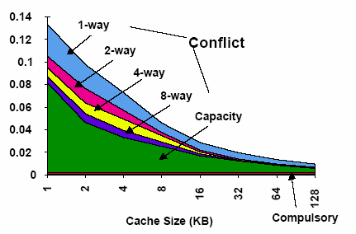
9. Cache Performance
Observations:
Cold/compulsory miss remains the same irrespective of cache size/associativity.
For the same cache size, conflict miss goes down with increasing associativity.
Conflict miss is 0 for FA caches.
For the same cache size, capacity miss remains the same irrespective of associativity.
Capacity miss decreases with increasing cache size .
Identical block size
Total Miss = Cold miss + Conflict miss + Capacity miss
Capacity miss (FA) = Total miss (FA) – Cold miss (FA), when Conflict Miss➔0

Slide 72
10. Block Replacement Policy (1/3)
Set Associative or Fully Associative Cache:
Can choose where to place a memory block
Potentially replacing another cache block if full
Need block replacement policy
Least Recently Used (LRU)
How: For cache hit, record the cache block that was accessed
When replacing a block, choose one which has not been accessed for the longest time
Why: Temporal locality

Slide 73
10. Block Replacement Policy (2/3)
Least Recently Used policy in action:
4-way SA cache
Memory accesses: 0 4 8 12 4 16 12 0 4
LRU
Access 4
0
4
8
12
Hit
Access 16
0
8
12
4
Miss (Evict Block 0)
x
Access 12
8
12
4
16
Hit
Access 0
8
4
16
12
Miss (Evict Block 8)
x
Access 4
4
16
12
0
Hit
16
12
0
4

Slide 74
10. Block Replacement Policy (3/3)
Drawback for LRU
Hard to keep track if there are many choices
Other replacement policies:
First in first out (FIFO)
Random replacement (RR)
Least frequently used (LFU)

Slide 75
11. Summary: Cache Organizations
One-way set associative
(direct mapped)
Two-way set associative
Set
Tag
Data
Tag
Data
Block
Tag
Data
0
1
2
3
0
1
2
3
4
5
6
7
Four-way set associative
Set
Tag
Data
Tag
Data
Tag
Data
Tag
Data
0
1

Slide 76
11. Summary: Cache Framework (1/2)
Block Placement: Where can a block be placed in cache?
Direct Mapped:
N-way Set-Associative:
Only one block defined by index
Any one of the N blocks within the set defined by index
Block Identification: How is a block found if it is in the cache?
Direct Mapped:
N-way Set Associative:
Tag match with only one block
Tag match for all the blocks within the set

Slide 77
11. Summary: Cache Framework (2/2)
Block Replacement: Which block should be replaced on a cache miss?
Direct Mapped:
N-way Set-Associative:
No Choice
Based on replacement policy
Write Strategy: What happens on a write?
Write Policy: Write-through vs write-back
Write Miss Policy: Write allocate vs write no allocate

Slide 78
12. Exploration: Improving Cache Penalty
Average Access Time
= Hit rate x Hit Time + (1-Hit rate) x Miss penalty
So far, we tried to improve Miss Rate:
Larger block size
Larger Cache
Higher Associativity
What about Miss Penalty?

Slide 79
12. Exploration: Multilevel Cache
Options:
Separate data and instruction caches, or a unified cache
Sample sizes:
L1: 32KB, 32-byte block, 4-way set associative
L2: 256KB, 128-byte block, 8-way associative
L3: 4MB, 256-byte block, Direct mapped
Processor
L1 I$
Reg
Unified
L2 $
Disk
Memory
L1 D$

Slide 80
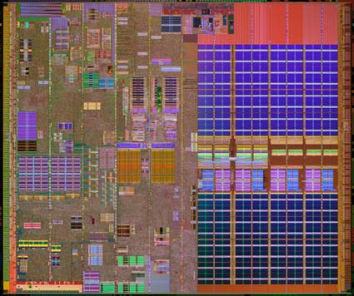
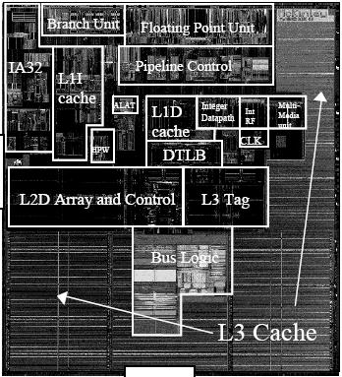
12. Exploration: Intel Processors
Pentium 4 Extreme Edition
L1: 12KB I$ + 8KB D$
L2: 256KB
L3: 2MB
Itanium 2 McKinley
L1: 16KB I$ + 16KB D$
L2: 256KB
L3: 1.5MB – 9MB

Slide 81
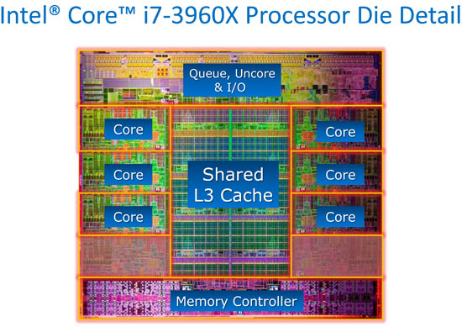
12. Exploration: Trend: Intel Core i7-3960K
Intel Core i7-3960K
per die:
2.27 billion transistors
15MB shared Inst/Data Cache (LLC)
per Core:
-32KB L1 Inst Cache
-32KB L1 Data Cache
-256KB L2 Inst/Data Cache
-up to 2.5MB LLC

